Slide 1
Revisions to CBA in TPM 2019 Issues Paper
28 April 2020

Slide 2
Purpose
To explain the revisions to the Authority’s estimates of the costs and benefits of the TPM proposal set out in the 2019 TPM Issues Paper, in light of submissions
To provide an opportunity for questions and answers
2

Slide 3
Agenda
1 Welcome, introductions and purpose | 09:30
2 Overview of revised CBA results | 09:35
3 CBA framework matters | 09:40
4 Key drivers of changed CBA results | 10:10
5 Break | 11:05 – 11.15
6 Key drivers of changed CBA results (continued) | 11:15
7 Other drivers of changed CBA results | 11:50
8 Scenarios / sensitivity analysis | 12:05
9 Closing comments | 12:25
10 Finish | 12:30

Slide 4
Overview of revised CBA results

Slide 5
Significant long-term benefits for consumers
Central scenario, $m | 2019 | Revised
Grid use efficiencies | 2,579 | 1,131
Utility scale battery investment efficiencies | 202 | 51
Investment efficiencies | 145 | 120
Grid investment brought forward | -188 | 60
Other costs | -27 | -27
Total | 2,711 | 1,335
Ranges | 0.2b – 6.4b | 0.4b – 2.4b

Slide 6
CBA framework matters
  Assesses the TPM proposal
  Uses an appropriate baseline
  Covers an appropriate timeframe
  Treats distribution investment costs appropriately

Slide 7
CBA framework matters
---
Time for questions

Slide 8
Key drivers of changed CBA results

Slide 9
Investment in utility-scale batteries

Slide 10
Feedback
Excessive utility-scale battery investment in the baseline because CBA modelling, amongst other things:
  Assumes constant, rather than diminishing, rate of decline in batteries’ capital cost
  Not based on model of optimal decision-making in response to economic inputs
  Assumes constant marginal profitability of battery investment
  Excludes costs of connecting batteries to distribution networks
  Ignores constraints on shifting load to avoid peak demand charges
  Excludes other benefits from battery investment

Slide 11
Changes made
Battery costs rate of decline starts at 11% p.a. then declines at 2% p.a.
20% increase in 2019 battery investment cost (to $1m / MW)
Expected earnings from battery investment:
  Optimal daily charge/discharge using 3 years (2017–2019) of demand, prices, transmission charges in wholesale electricity market
  2% allowance for uncertainty in predicting RCPD periods.
  Adjustment to account for wholesale price effects caused by demand/supply changes due to batteries charging/discharging

Slide 12
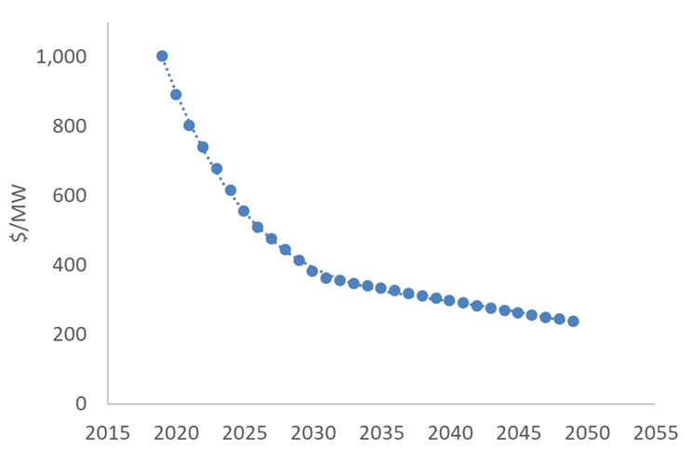
Battery cost function
Compound annual growth rate: -4.85%
    2019–2030, rate of decline average of 9% p.a. – faster than 2019 CBA
    2030–2049, rate of decline average of 3% p.a. – slower than 2019 CBA
Includes capital cost, connection cost and fixed annual operating and maintenance cost (2.5% of capital cost)
Present value cost ($/MW) for 1 MW battery with energy-to-power ratio of 1 (1 MWh battery)

Slide 13
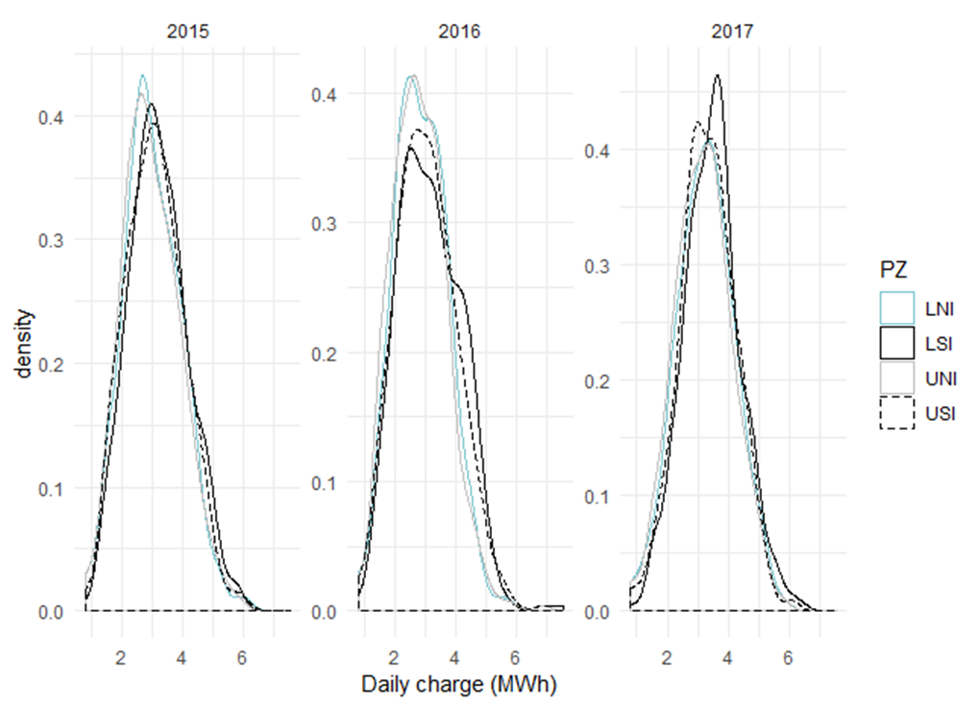
Battery charge/discharge cycles
Strategy includes not charging within 100 peak periods
  Defined by lower bound of actual 100 peak MW periods less 2% to account for forecast error
Operational minimum and maximum state of charge 0.1–0.9

Slide 14
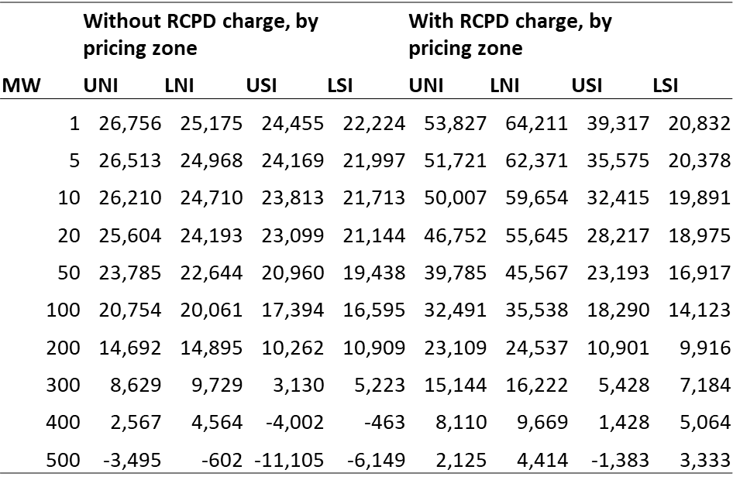
Annual earnings per MW (revenue less energy cost)
Earnings are highest in transmission pricing regions with peakiest load
For large installations, RCPD makes batteries less profitable
  Limits scope for energy arbitrage once RCPD avoidance possibilities exhausted

Slide 15
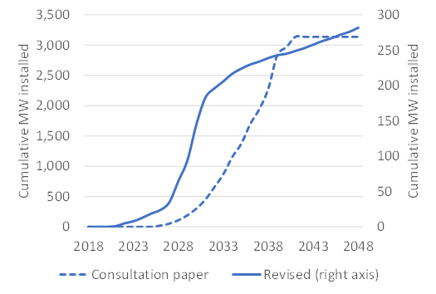
Results (MW capacity)
Baseline investment is much lower, but comes much earlier

Slide 16
Investment in utility-scale batteries
---
Time for questions

Slide 17
Investment in new electricity generation

Slide 18
Feedback
Generation investment occurring yet wholesale electricity prices falling
Increased electricity demand but lower wholesale electricity prices
Generation investment occurring yet inadequate revenue to recover cost of new generation investment
Inadequate accounting for suppressed wholesale electricity prices caused by generation investment

Slide 19
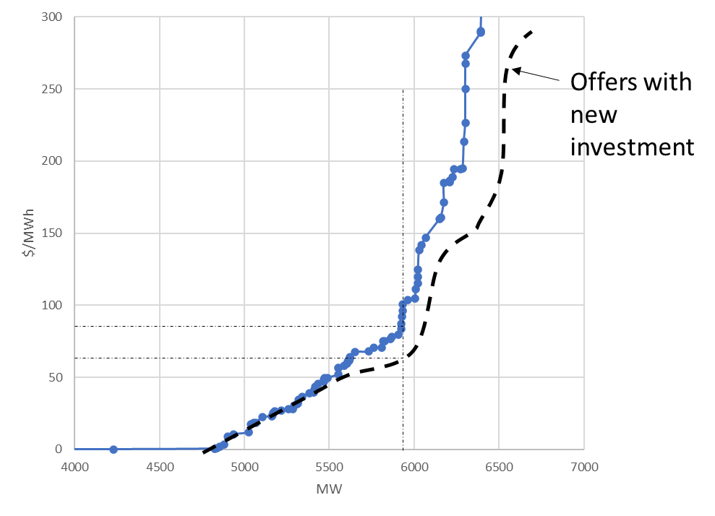
Changes made
Earnings on new generation based on price received once capacity and offers added to market
Sequential decision rule used
  1 generation investment in a year only if investment profitable given effect on wholesale electricity prices
  ≥ 2 generation investments in a year only if all investments profitable given effect on wholesale prices

Slide 20
Results
Less generation investment than in 2019 CBA
  2019 CBA had 1–1.5 GW of generation investment
  2020 CBA has 838–883 MW of generation investment
    838 MW under the TPM proposal
    883 MW under the baseline
NB: Generation investment is path dependent

Slide 21
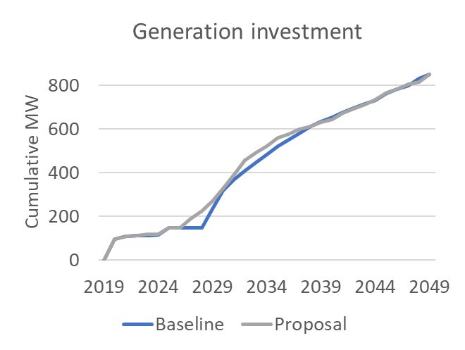
Results (contd)
Generation investment, cumulative peak MW, average of scenarios
Commissioning of generation investment

Slide 22
Should CBA include generation investment costs?
Why are battery investment costs treated differently?

Slide 23
Are there wealth transfers from generators to consumers?

Slide 24
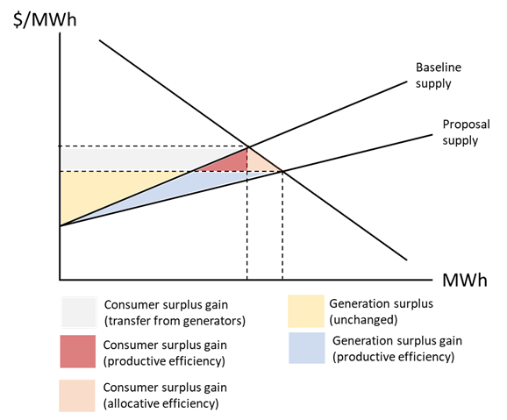
Wealth transfers: Long-run energy price effect
NERA’s diagram for Meridian, based on one shown at Authority’s 2019 CBA workshop illustrates the effects the CBA is capturing

Slide 25
Investment in new electricity generation
---
Time for questions

Slide 26
Break

Slide 27
Wholesale electricity price formation

Slide 28
Feedback
Modelled wholesale electricity prices do not adequately account for:
  Supply risks
  All costs factored into wholesale market offers (e.g. scarcity value of water)
Increased volatility in wholesale electricity prices not factored into generation investment decisions
Caps and floors on wholesale electricity prices undermine robustness of CBA results

Slide 29
Changes made
Use typical annual offer curves based on grid-connected generators’ offers for 2015–2017
  Accounts for value of water
  Offer curves measured relative to short-run marginal costs, so curves shift up / down as SRMC changes over time
  Numerous plant can be part-dispatched
  Prices less sensitive to small demand changes, other things being equal
  No need to use floors and ceilings on wholesale electricity prices

Slide 30
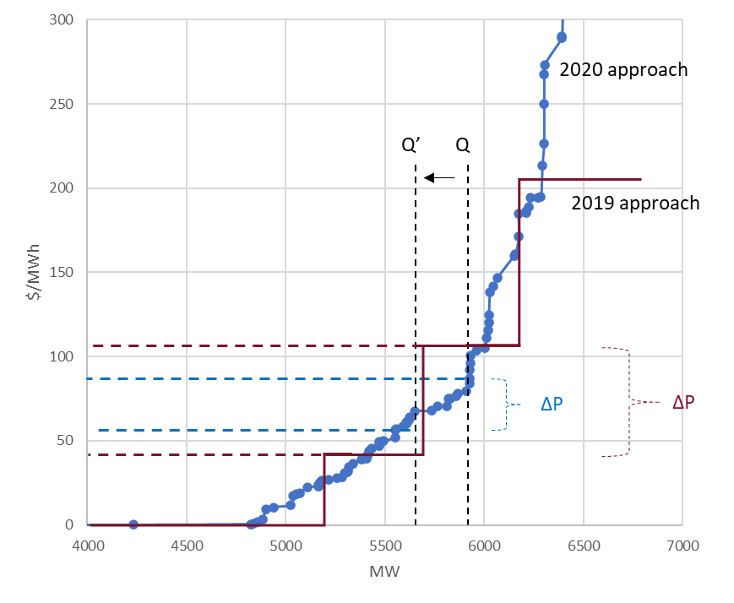
Stylised example
Stylised example shows annual price changes during peak periods
2020 approach uses offers
2019 approach used SRMC

Slide 31
Changes made (contd)
Use adaptive consumer wholesale price expectations – take account of:
  Average of past two years’ wholesale electricity prices inclusive of transmission charges
  Current year’s expected wholesale prices based on same demand growth as year
Set final wholesale electricity prices for a year once all demand and generation investment determined for that year
  Previously based on consumers’ expectations of wholesale electricity prices inclusive of transmission charges for that year

Slide 32
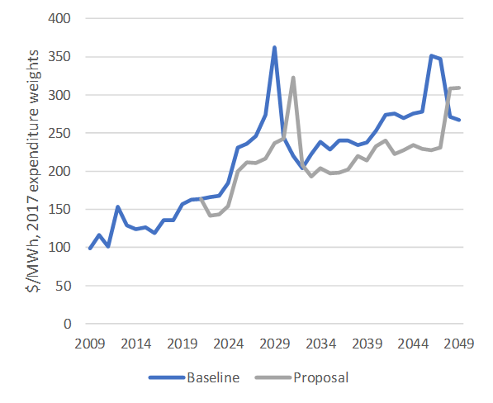
Results
Using offer curves allows for higher wholesale electricity prices inclusive of transmission charges when generation scarce
Generation investment occurs more quickly under TPM proposal
Spikes in wholesale electricity prices in mid-to-late 2020s reflect decommissioning of Huntly capacity – 500 MW in 2024, 50 MW in 2028
Average wholesale electricity prices inclusive of interconnection charges

Slide 33
Wholesale electricity price formation
---
Time for questions

Slide 34
Cost of grid investment brought forward

Slide 35
Feedback
Costs may be underestimated by an arbitrary averaging of costs across scenarios
Incremental costs of grid investments could be higher than average costs

Slide 36
Changes made
Use long-run incremental cost of transmission in each of the 4 transmission pricing regions
Our revised approach:
  Is based on estimated transmission needed to meet incremental demand per year in each transmission pricing region
  Links our estimate of enhancement and development (E&D) transmission expenditure for 2035–2050 to anticipated major capital projects over this period

Slide 37
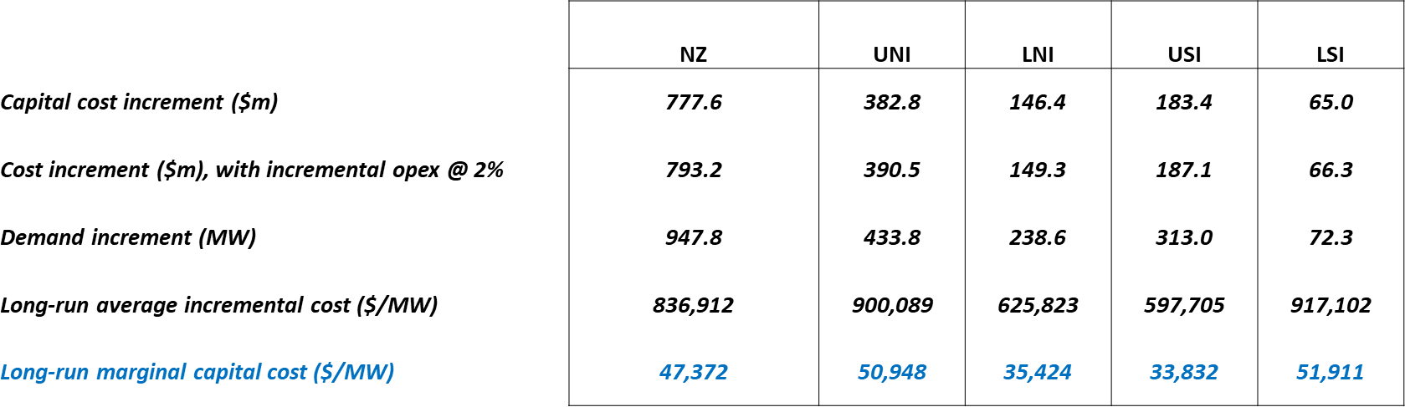
Long-run incremental transmission cost
Transpower (2017) “Battery storage in New Zealand” cites transmission LRMC in a range of $30,000 – $80,000 / MW / year
Present value (discount rate 6%)

Slide 38
Results
$35m (-$2m – $56m) = cost of transmission investment brought forward to meet additional peak demand under TPM proposal
  Much less than under 2019 CBA ($311m)
  Much less battery investment under baseline means peak demand under baseline grows at level closer to level under TPM proposal
$95m ($5 – $129m) = benefit of lower transport costs from bringing forward reduction in losses and constraints ($123m under 2019 CBA)
So, net benefit of $60m ($7m – $73m) (-$188m under 2019 CBA)

Slide 39
Grid investment brought forward
---
Time for questions

Slide 40
Other drivers of changed CBA results

Slide 41
Increased scrutiny of transmission investment

Slide 42
Feedback
Unclear how further savings from increased grid investment scrutiny
Less expenditure could mean costs / foregone benefits (fewer services, less reliability, more future expenditure)
Participants may not have skills / resources to propose more efficient alternative investment proposal
Single observation not reliable
Controversy around every transmission investment proposal would make this aspect of the CBA a cost (eg, increased litigation)

Slide 43
Changes made
Litigation costs also allowed for (6 x $1.5m spread evenly across 30 years)

Slide 44
Results
Approx. 35% decrease in estimated net benefit
2020 CBA: $49m ($9m – $98m)
2019 CBA: $77m ($29m – $125m)

Slide 45
Increased investor certainty

Slide 46
Feedback
No evidentiary basis for benefits
Benefits from increased certainty calculations are a ‘random number generator’
  Because calculations rely on assumed base level of 100
Authority’s workings have algebraic error, which causes incorrect formula for:
  The equilibrium price, and
  The effect of uncertainty on price

Slide 47
Changes made
Investment effects calculated directly from elasticity of investment to change in uncertainty, so that benchmark uncertainty level not required
Algebraic error in workings corrected
  Price effects of changes in uncertainty should be zero when uncertainty assumed to have same effect on demand and on supply
  Results in higher benefit than presented in 2019 CBA

Slide 48
Results
Approx. 20% increase in estimated net benefit
2020 CBA: $31m ($11m – $59m)
2019 CBA: $26m ($10m – $48m)

Slide 49
Other drivers of changed CBA results
---
Time for questions

Slide 50
Scenarios and sensitivities

Slide 51
Other policy scenarios modelled
We have modelled 3 other policy scenarios:
  Alternative to the TPM proposal
    RCPD charge with “N = all trading periods” (i.e. a per-MWh charge)
  TPM proposal ‘future-only’ scenario
    Benefit-based charge applies only to future grid investments
  TPM proposal ‘HVDC’ scenario
    Benefit-based charge applies only to HVDC investments and future grid investments

Slide 52
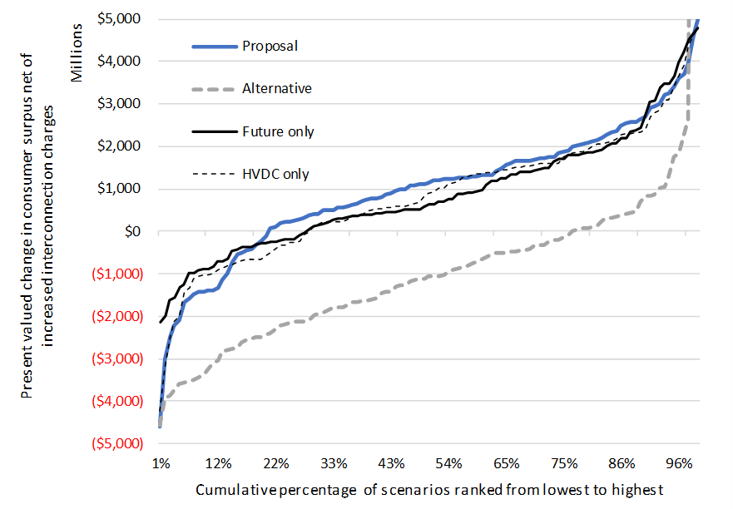
Summary of sensitivity of grid use benefits
Mean | Proposal | Alternative | Future Only | HVDC only
Net benefit | 1,169 | -760 | 1,130 | 594
$2018 millions, present value, weighted mean
Median | Proposal | Alternative | Future Only | HVDC only
Net benefit | 1,335 | -927 | 834 | 1,117
$2018 millions, present value
(Note: Top of y-axis is shortened to exclude two extreme values under the Alternative)

Slide 53
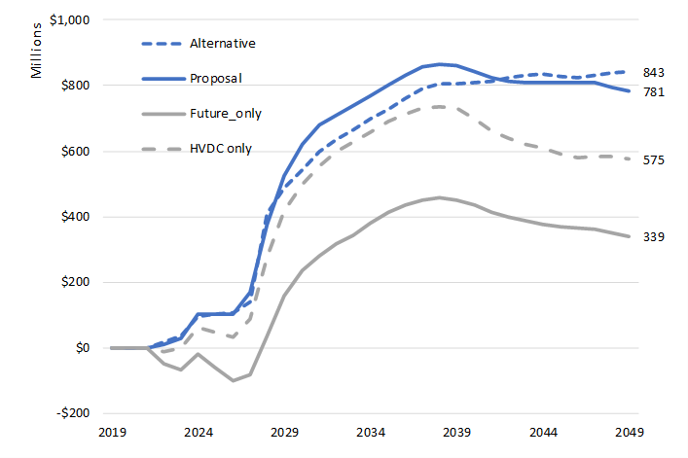
Summary of total surplus for policy scenarios
$2018 millions, present value, weighted average

Slide 54
Scenarios and sensitivities
---
Time for questions

Slide 55
THANK YOU

Slide 56
Other CBA matters

Slide 57
Wholesale price pass-through and consumer responsiveness

Slide 58
Empirical matters related to consumer responsiveness

Slide 59
Demand model(s) – elasticities
Distribution-connected demand
Grid-connected demand
Time of use elasticities, holding total expenditure constant
 | Quantity
Price | Peak | DG peak | Shoulder | Off peak
Peak | -0.49 | 0.03 | -0.13 | -0.43
DG peak | 0.61 | -0.40 | -0.88 | 0.21
Shoulder | -0.18 | -0.09 | -0.23 | -0.49
Off peak | -0.26 | 0.00 | -0.21 | -0.55
Expenditure | 1.011 | 0.467 | 0.991 | 1.016
Adjusted for aggregate demand elasticity (-0.11 from dynamic panel)
 | Quantity
Price | Peak | DG peak | Shoulder | Off peak
Peak | -0.05 | 0.00 | -0.01 | -0.05
DG peak | 0.07 | -0.04 | -0.10 | 0.02
Shoulder | -0.02 | -0.01 | -0.03 | -0.05
Off peak | -0.03 | 0.00 | -0.02 | -0.06
Time of use elasticities, holding total expenditure constant
 | Quantity
Price | Peak | DG peak | Shoulder | Off peak
Peak | -0.13 | -1.08 | -0.29 | -0.25
DG peak | -0.02 | 1.33 | -0.03 | 0.00
Shoulder | -0.20 | -1.93 | -0.08 | -0.19
Off peak | -0.64 | 0.70 | -0.60 | -0.57
Expenditure | 0.988 | 0.980 | 0.991 | 1.007
Adjusted for aggregate demand elasticity (-0.02 from cost model)
 | Quantity
Price | Peak | DG peak | Shoulder | Off peak
Peak | -0.003 | -0.024 | -0.006 | -0.006
DG peak | 0.000 | 0.029 | -0.001 | 0.000
Shoulder | -0.004 | -0.042 | -0.002 | -0.004
Off peak | -0.014 | 0.015 | -0.013 | -0.012

Slide 60
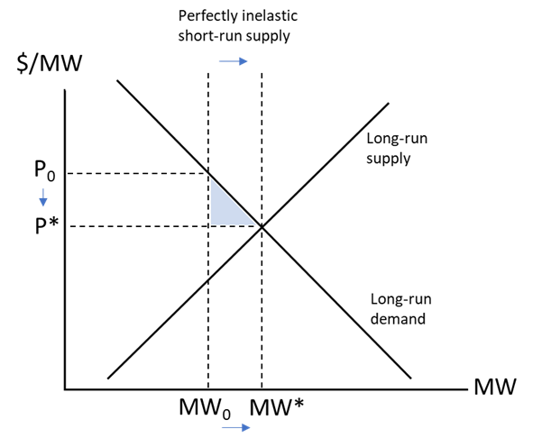
Distribution investment costs: Authority’s current view
If distribution investment costs increase, then so do distribution benefits

